Slide 1


Naive Bayes Classification: Furniture Sales Dataset Analysis
Exploring the sales dataset of a company to understand the application of Naive Bayes classification in real-life business scenarios. The dataset includes 'Order_ID', 'Order_Priority', 'Order_Quantity', 'Sales', 'Ship_Mode', 'Profit', 'Customer_Name', 'Region', 'Customer_Segment', 'Product_Category', 'Product_Sub-Category', 'Product_Name', and 'Product_Container'.
Submitted by :-
Gaurang Ashava RA2111027010007
Safal Mehrotra RA2111027010006

Slide 2
Understanding the Sales Dataset
Data Distribution
Customer Segmentation
Product Categorization
Detailed breakdown of order quantity, sales, profit, and more.
Analyzing sales data based on customer segments such as region, priority, and mode of shipment.
Exploring the dataset to understand the distribution across different product categories and sub-categories.

Slide 3
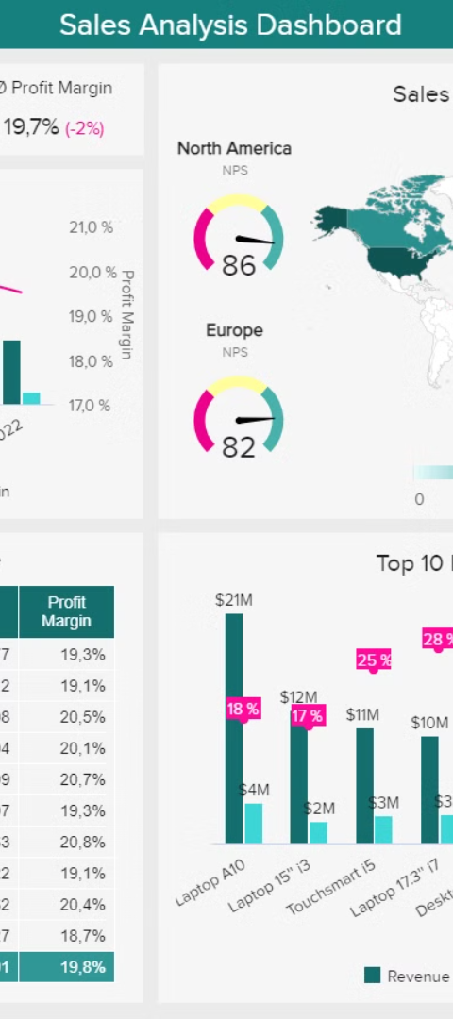



Key Patterns & Trends
Seasonal Variations
Identifying patterns in sales data based on different seasons and trends.
Regional Insights
Exploring how sales vary across different regions based on the dataset.
Customer Behavior
Understanding patterns in customer behavior related to product purchases and order priority.

Slide 4

Naive Bayes Classification Basics
1
Probability Model
2
Independence Assumption
Explaining the fundamental principles of Naive Bayes classification based on probability.
Understanding the assumption of independence between features in Naive Bayes.
3
Real-world Examples
Illustrating how Naive Bayes is used in real-world scenarios including sales predictions.

Slide 5
Impact of Naive Bayes Analysis
Insights Generation
1
How Naive Bayes helps in generating valuable insights for sales strategies.
2
Efficiency Improvement
Enhancing operational efficiency in sales processes through classification analysis.
Decision-making Support
3
Empowering informed decision-making based on the analysis output.

Slide 6
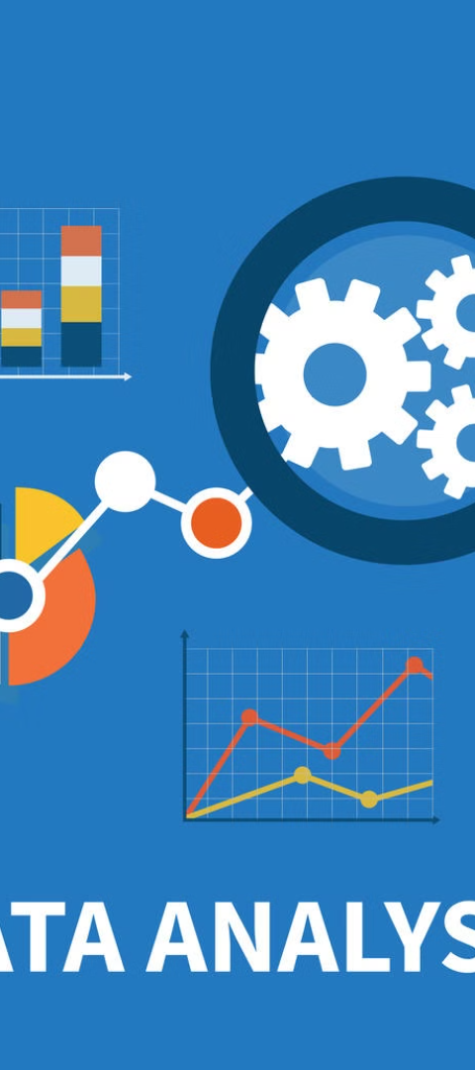
Challenges & Limitations
Handling Missing Data
Outlier Detection
Addressing challenges related to incomplete or missing data points in the sales dataset.
Identifying and managing outliers in the data to ensure accurate analysis results.
Assumption Validity
Ensuring the validity of independence assumptions for accurate classification results.

Slide 7
Future Scope & Recommendations
Enhanced Data Collection
Optimizing data collection processes to ensure comprehensive and accurate analysis.
Advanced Model Iterations
Exploring advanced Naive Bayes models for improved sales predictions and insights.
Industry-specific Applications
Adapting Naive Bayes techniques, suit specific industry requirements for impactful analysis.

